Slide 1
Ready 4 Kindergarten: Maryland’s Early Childhood Comprehensive Assessment System
Kindergarten Readiness Assessment App

Slide 2
Kindergarten Readiness Assessment
Professional Development by Johns Hopkins School of Education, Center for Technology in Education
Notes:
This PowerPoint gives you information about the Kindergarten Readiness Assessment App.

Slide 3
Notes:
The Ready for Kindergarten Online app is free and available through the Apple App Store. The app is only available for iPads. Please be sure to choose the correct app as there are numerous apps available. The one you’re looking for has the orange background with the green checkmark.

Slide 4
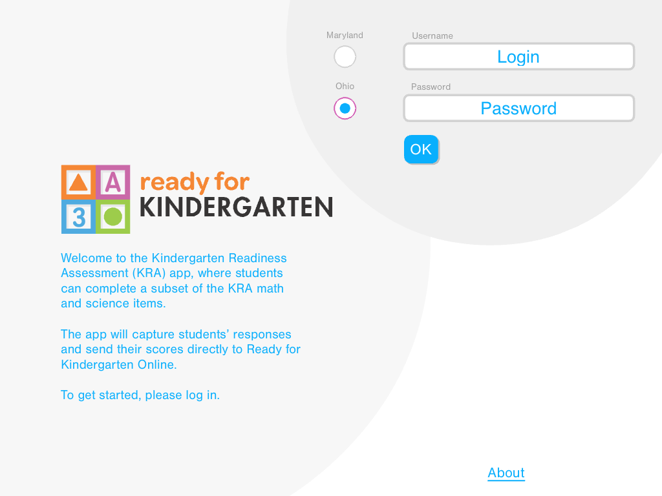
Notes:
Once you download the app, you see the log in screen. Choose your state, enter your username and password.

Slide 5
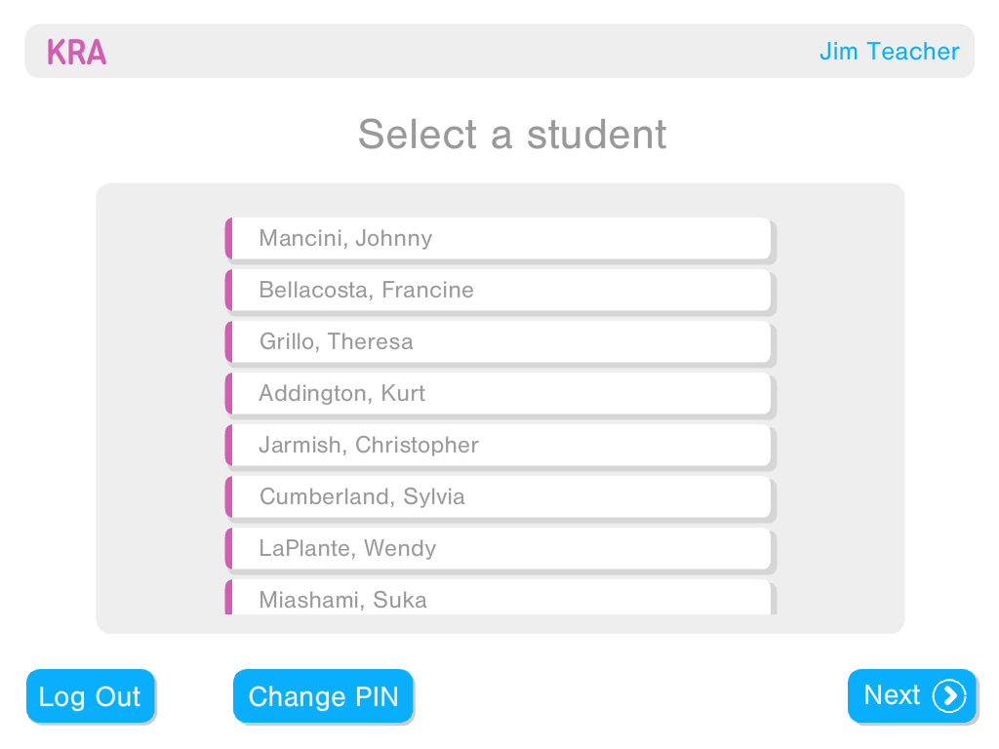
Notes:
You see a screen that includes all of the children in your classroom. When you select an individual child, you simply touch his/her name.

Slide 6
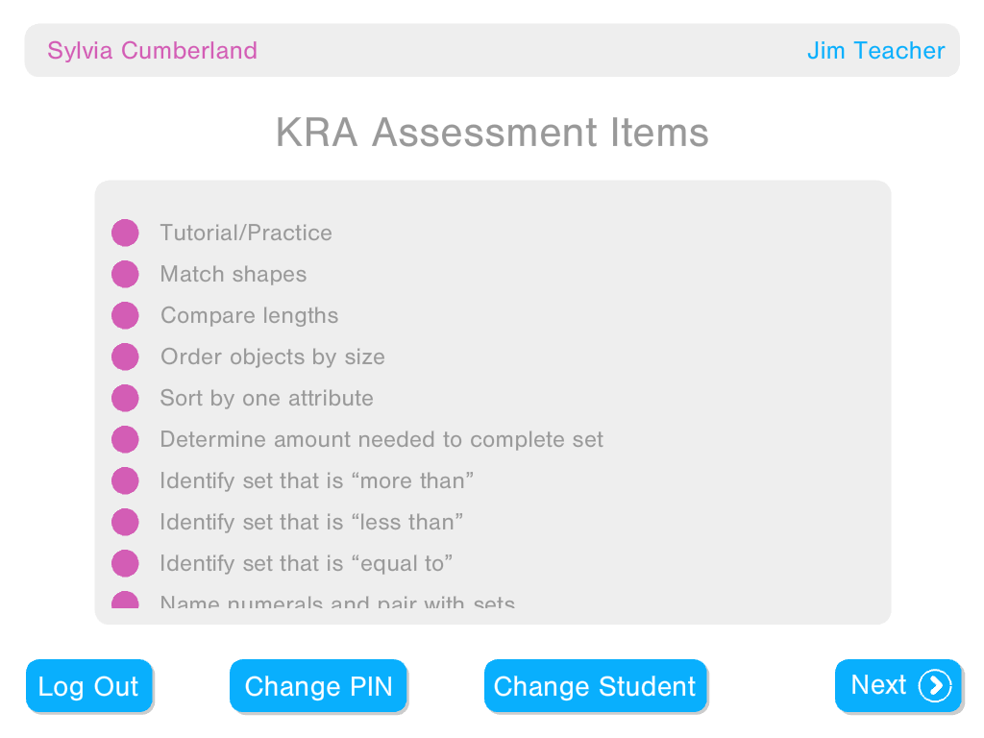
Notes:
A list appears of items that child needs to take. There is a purple dot next to each item the child needs to take.

Slide 7
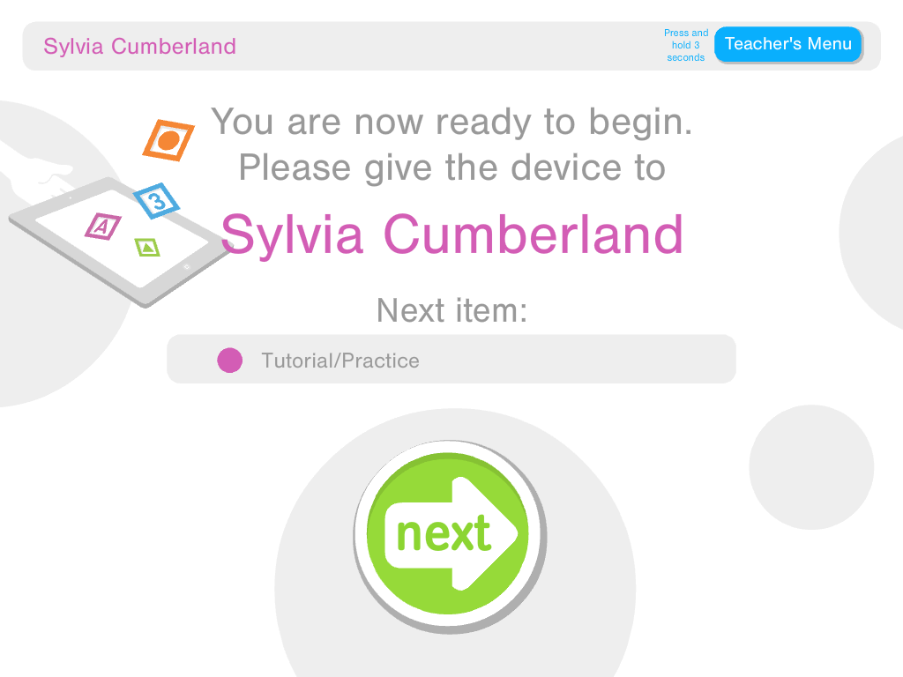
Notes:
To start, simply touch the item and hand the iPad to the child. The teacher or the child press the green next button to start.

Slide 8
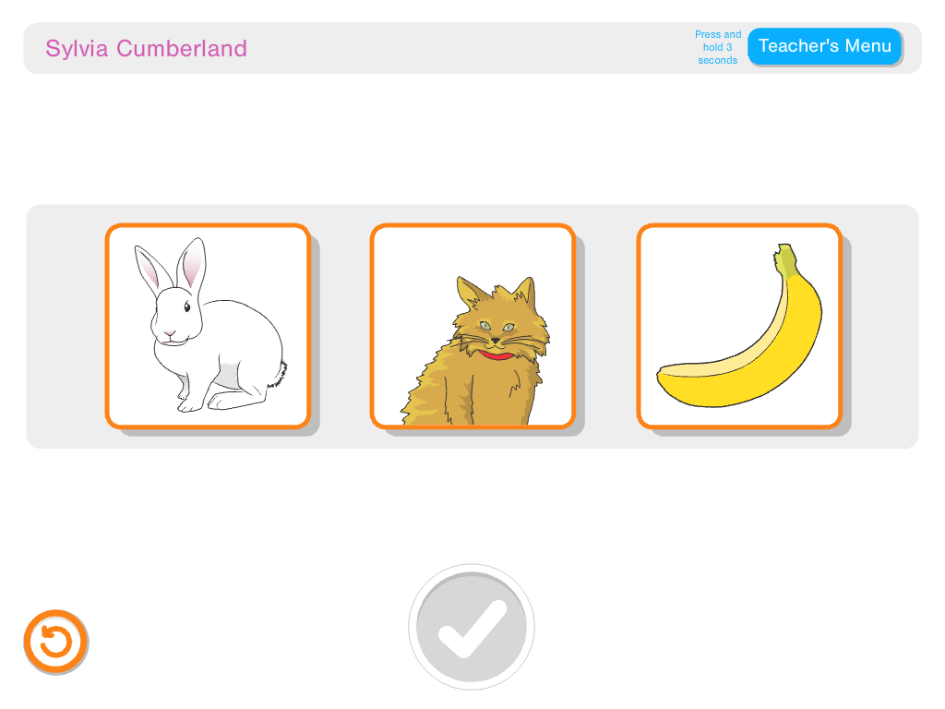
Notes:
This slide shows the tutorial item for the KRA App. The child listens to the voice over and responds to the item by touching a picture. The child also has a chance to learn about the repeat button (the orange button in the bottom left corner of the screen). The child learns that he/she can press that button any time they want to listen to the voice over directions again. There is no limit on the number of times a child can repeat directions. This is consistent with the universally designed allowances used with the print version of the assessment.

Slide 9
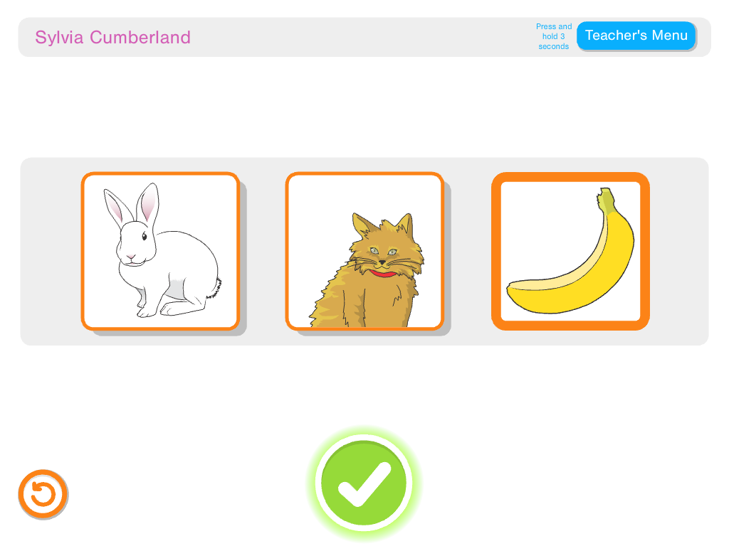
Notes:
Once the child selects his or her response, the child is prompted to press the green button to continue. The voice does not confirm whether or not the child got the answer correct. Again, this is consistent with administration of the items using the print version.

Slide 10
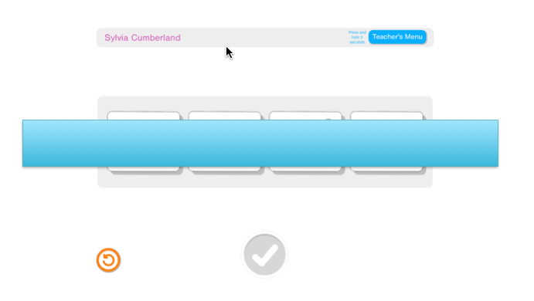
Notes:
This slide shows an example of an item. Due to test security, the actual item on this slide is covered by the blue box. For this item, the child slides the four boxes into a specific order according to the spoken directions from the app (e.g., from smallest to largest). Once the voice reads the scripted directions, the objects in the four boxes jiggle, prompting the child to begin moving the objects into order. Once all objects are placed, the check mark turns green and the child can press it when he/she is ready to do so. Notice the orange repeat button is visible on each page the child interacts with in the App.

Slide 11
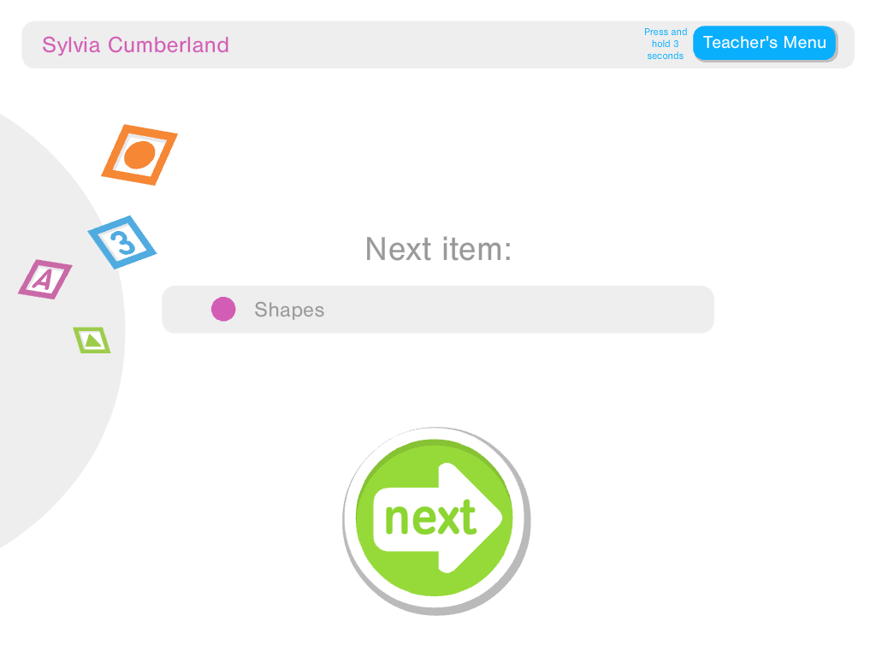
Notes:
When a child completes an item and submits his/her answer by clicking on the green check mark, he/she come to the next slide which provides a quick break before moving to the next item. Most children quickly click the Next button to continue. However, they are welcome to pause here before continuing to the next item.

Slide 12
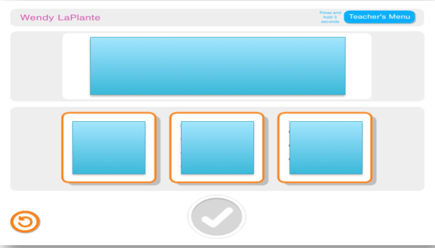
Notes:
As the child moves through the items, the orange boxes provide visual signal. In this case it reinforces that the child can choose an answer from one of the three highlighted boxes.

Slide 13
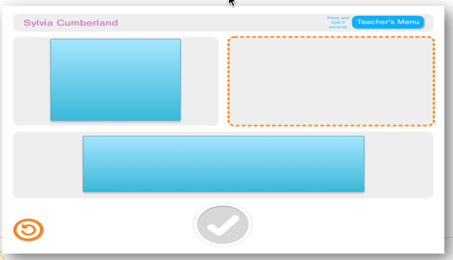
Notes:
Here’s another example of the use of an orange box. In this case, the box is highlighted as the voice over is spoken to let the child know where he/she is supposed to drag items to complete the task. Once the child completes the task, the green check mark lights up prompting the child to press it in order to continue.

Slide 14
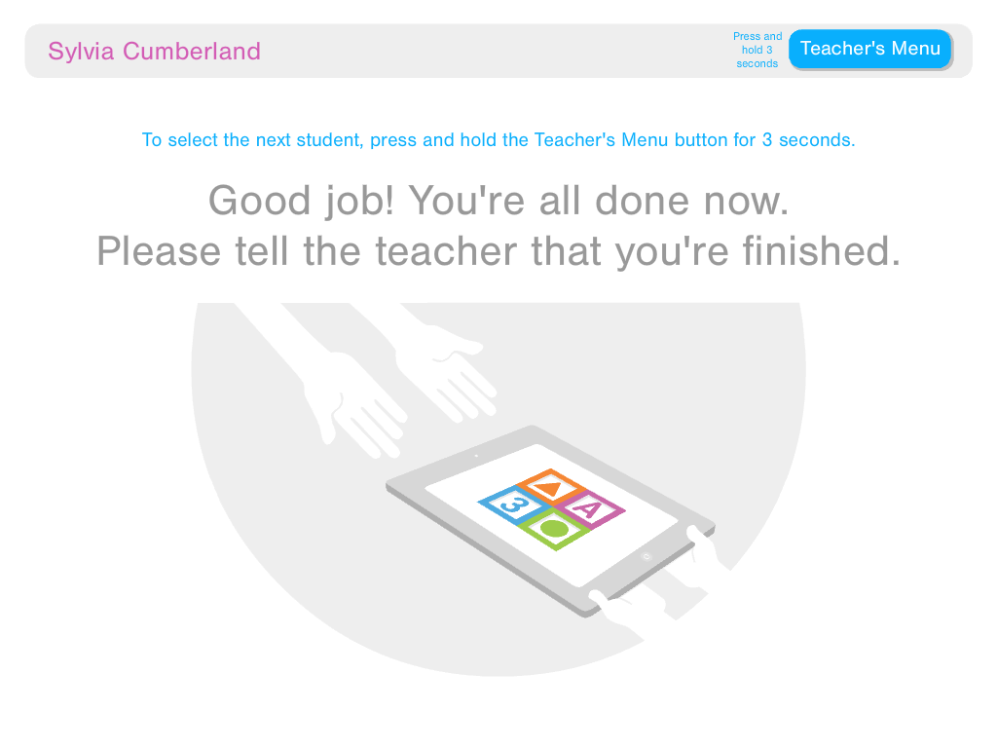
Notes:
When the child completes all 12 items, this screen appears congratulating the child on completing the items and prompting him/her to return the iPad to the teacher. If at any time the teacher wants to use the app with another child or go back to the main menu, he/she simply presses the blue Teacher Menu button in the top right corner. The teacher needs to hold the button for 3-5 seconds and enter a PIN code.

Slide 15
Notes:
This screen shows the PIN entry page. The teacher enters his/her PIN here. Teachers select their own PIN and can reset it at any time. Having the PIN entry screen helps ensure that only the teacher can access the Teacher Menu options.

Slide 16
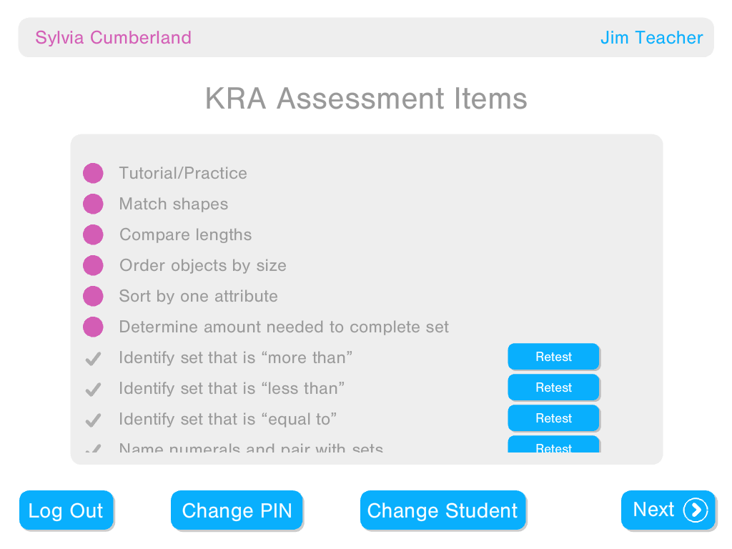
Notes:
Teachers also have the option to retest a child at any point either using the iPad or the print version of the items. Once a child completes an item, the purple button changes to a check mark and the Retest button becomes available.

Slide 17
Need Additional Support?
Check out the technology resources section of the KRA website
Professional Development by Johns Hopkins School of Education, Center for Technology in Education

